Slide 1
Automating Almost All Application Security Things with CI/CD
Even Honeypots!
Mick Douglas and Andy Douglas
Link to slides+resources at end!

Slide 2
Where is application security?
Notes:
Mick
Where in your SDLC is application security? The trend in application security is to “shift left,” but what tools and techniques should we employ in order to balance security coverage against developer velocity? What about the cost of licensing security tools and having skilled personnel to operate them?

Slide 3
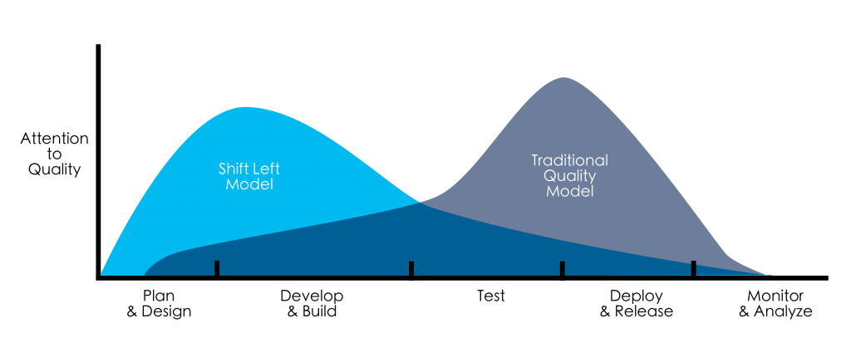
Notes:
Mick
Added Image source: https://devopedia.org/shift-left

Slide 4

Continuous
Integration
Continuous Delivery
or Deployment
Development
Notes:
Andy
Many software organizations are following processes that include continuous integration and some form of continuous delivery or continuous deployment. CI/CD automation offers amazing opportunities to improve the security of your applications as they make their way from developer laptop to Production.

Slide 5

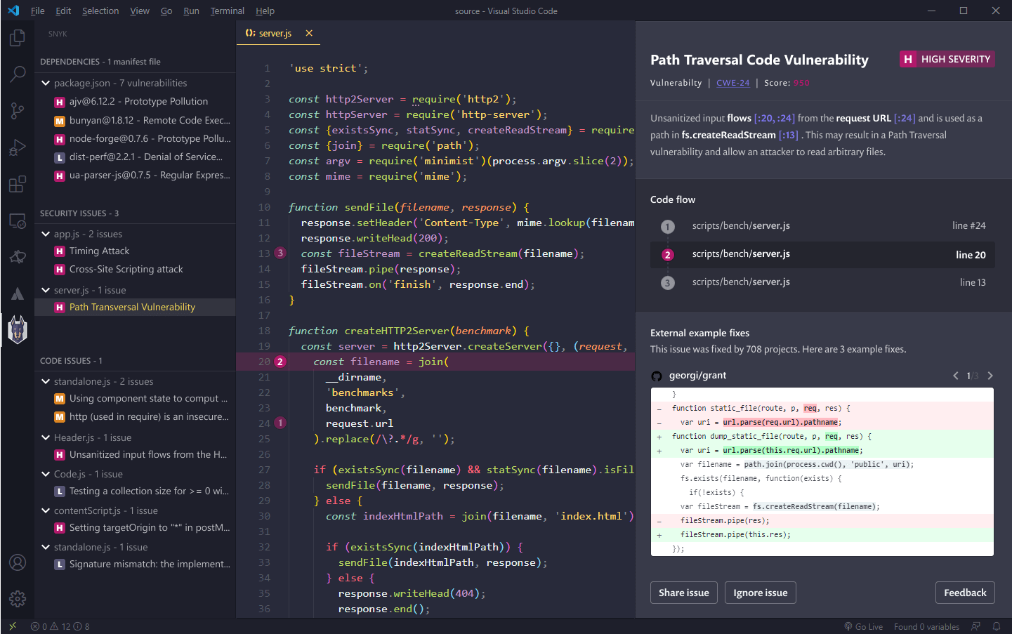
Continuous
Integration
Continuous Delivery
or Deployment
Development
Notes:
Andy
With static application security testing or SAST, you can shift all the way left into your IDE to discover security vulnerabilities as you write code, and…

Slide 6

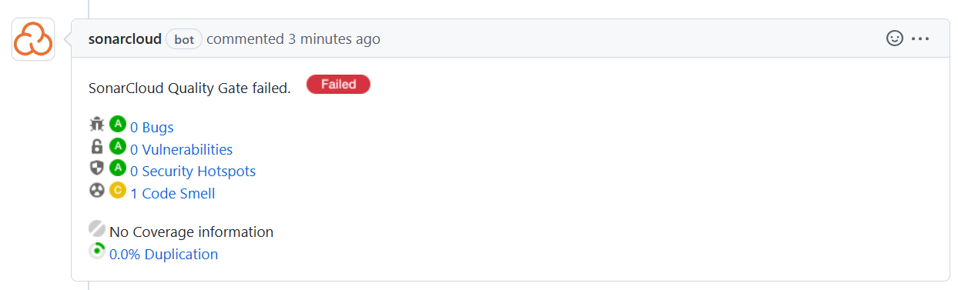
Continuous
Integration
Continuous Delivery
or Deployment
Development
Notes:
Andy
…and SAST tools can also be incorporated into your CI pipelines to detect vulnerabilities before they get merged into your “main” branch, prior to deployment taking place

Slide 7

Continuous
Integration
Continuous Delivery
or Deployment
Development
Notes:
Andy
When you deploy, regardless of whether you have an automated deployment pipeline or manually initiate deployments, Dynamic Application Security Testing or DAST can quickly scan your application as it makes its way through your environments

Slide 8
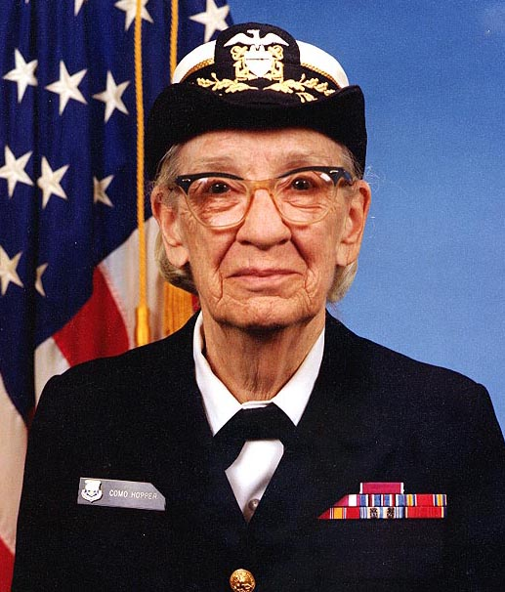
The hardest thing in the world is to change the minds of people who keep saying, ‘But we’ve always done it this way.’ These are days of fast changes and if we don’t change with them, we can get hurt or lost.
Grace M. Hopper
Notes:
Mick
Status quo isn’t working
Grace Hopper image: https://commons.wikimedia.org/wiki/File:Grace_Hopper.jpg

Slide 9
2022 IBM report: Average time to detect data breach is 287 days
https://www.ibm.com/reports/data-breach
Notes:
Mick
Added

Slide 10
Continuous
Integration
Continuous Delivery
or Deployment
Development
Active Defense
Notes:
Mick
So let’s start making things tamper evident.

Slide 11
Automate Application Security with CI/CD
Notes:
Mick
Application security is transitioning away from scans and other hardening activities done late in the software development lifecycle to “shifting left” by way of automation that executes well before software makes its way into Production. This talk covers how to embrace this transition of “shifting left” and focuses on technologies you can quickly and cheaply incorporate into your existing pipelines to greatly improve your security posture while minimizing disruption to the software development lifecycle or burdening software developers on your team.

Slide 12
Part 1: Static and Dynamic Scans for prevention
Notes:
Andy
This talk is divided into 2 sections: part 1 focuses on preventing security vulnerabilities from making it to Production via static and dynamic scans integrated into your CI/CD pipelines and…

Slide 13
Part 2: Active Defense for detection
Notes:
Mick
… part 2 focuses on Active Defense techniques you can incorporate into your pipelines. We’ll explain what Active Defense is, and how you can and should incorporate honeypots and other Active Defense tools and techniques into your software pipelines.

Slide 14
Goal: Actionable Security Improvement
Notes:
Andy
The tools and techniques we’ll show you in this session do not require substantial security expertise and are completely free to use save for a little of your time. Our hope is that this content is relevant and highly actionable for you; when you leave CodeMash, we hope that the content and demos we have for you will inspire you to take action to improve the security posture of your organization.

Slide 15
Hi, my name is Andy Douglas
Long-time CodeMash attendee, first-time speaking
Full Stack Web Dev/Engineer > Architect > Engineering Manager
Security…meh
Notes:
Andy
I’m passionate about delivering high-quality software that delights users, without jumping through lots of hoops like security scans. In Part 1 of this talk I’ll be introducing some concepts and demonstrating a free/open-source tool that you can easily incorporate into your existing pipelines to automate security scans so you can focus on building great software with more piece of mind on the security front. I’m excited to be co-presenting today alongside my brother Mick!

Slide 16
Hi, my name is Mick Douglas
First time CodeMash attendee
Passionate about security
Infosec Innovations, SANS Principle Instructor, IANS Research Faculty
Notes:
Mick
Gaaah security smash

Slide 17

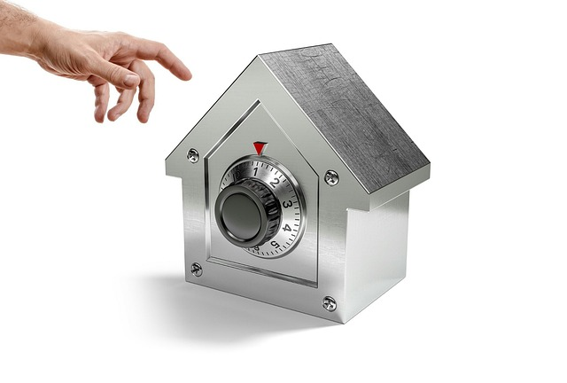
Part 1: Static and Dynamic Scans for prevention
Notes:
Andy
Spider image from: https://pixabay.com/photos/spider-arachnid-spider-web-cobweb-281142/
Safe image from: https://pixabay.com/photos/fraud-crime-hand-security-safety-3229757/

Slide 18
Static Application Security Testing (SAST)
Notes:
Andy
Static Application Security Testing is about scanning source code for security vulnerabilities. You may be accustomed to linters, style analysis tools, or others integrated with the IDE or the CI pipeline which scan your source code, and this concept is quite similar. With SAST, we’ll execute scans of source code at CI time or via direct IDE integration.

Slide 19
Notes:
Andy
This talk doesn’t include a detailed look at static tools b/c we wanted to focus on Dynamic scanning and Active Defense. But as an example of what’s possible, this is a screenshot from “Snyk Code” integrating with Visual Studio Code, highlighting a Path Traversal vulnerability in a node.js script. By the way, neither Mick nor myself have any financial interest in any tools that appear in this presentation; we do mention and even recommend some specific tools, but we are in no way benefiting from these recommendations.
Source - Snyk Code: https://snyk.io/blog/developer-first-sast-with-snyk-code/

Slide 20
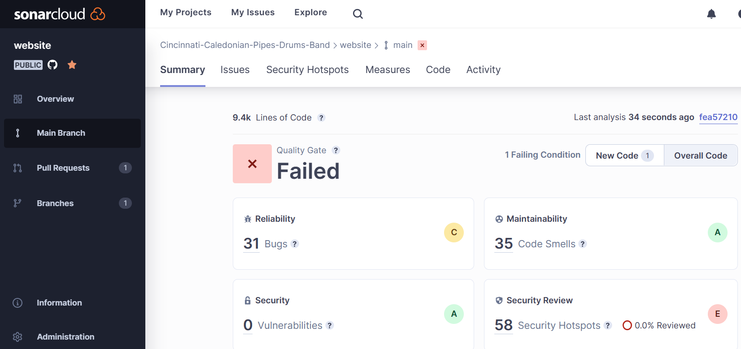
Notes:
Andy
Another great way to implement SAST is in your CI pipelines. During CI time, your application source code is available, and SAST scanners like SonarCloud shown here can uncover vulnerabilities prior to these issues making it further down your pipelines. Many SAST scanners integrate quite well with other tools; here’s SonarCloud integrating with my GitHub repository due to a “Code Smell” which it regards as a failure condition.

Slide 21
SAST Strengths
Notes:
Andy
SAST tools are good at detecting vulnerabilities like SQL injection, buffer overflows, and other well-known issues, and they offer automated support for detecting vulnerabilities as early as during coding time in the IDE, so SAST is a great way to “shift security left.”
https://owasp.org/www-community/Source_Code_Analysis_Tools

Slide 22
SAST Weaknesses
Notes:
Andy
Some SAST weaknesses include:
Being bad at detecting many vulnerabilities e.g. authentication issues, access control, cryptography issues
Lots of false positives where a vulnerability is detected which actually doesn’t exist
Expensive tools - (Snyk Code costs between $100-$140 per dev per month. SonarCloud is free for open source projects. Though costs vary widely.)
https://owasp.org/www-community/Source_Code_Analysis_Tools

Slide 23
Recommendation:
Integrate SAST w/ IDE + CI
Popular Tools: Snyk, Checkmarx, SonarQube/SonarCloud
Notes:
Andy
DO integrate SAST into your CI pipelines if you have the budget, and ideally into your IDE
Popular SAST tools include: Snyk, Checkmarx, SonarQube/SonarCloud (btw we’re not benefiting at all from any of these recommendations)
OWASP has some great advice regarding how to select a SAST tool - link at end

Slide 24
Software Composition Analysis (SCA)
Notes:
Andy
SCA = Software Composition Analysis to automate detection of vulnerable outdated packages/libraries.
Upgrade or replace vulnerable libraries: NuGet/Maven/PyPI/etc

Slide 25
npm , Maven, NuGet, pip, etc.
Notes:
Andy
If you’re using a package manager to include third-party software, it’s very common for these packages to have security vulnerabilities. Software Composition Analysis tools help you automate detecting these vulnerable packages, and even auto-update them.

Slide 26
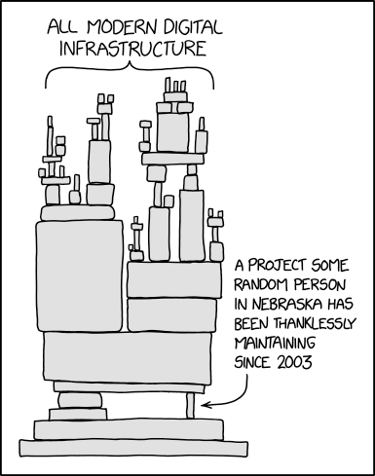
Notes:
Andy
SCA isn’t new, but organizations in almost all industries are increasingly using open source packages to expedite their delivery of software Source: https://www.explainxkcd.com/wiki/index.php/2347:_Dependency

Slide 27
Recommendation:
SCA: CI or scheduled
Popular Tools: Dependabot, Prisma Cloud, Snyk, Xray
Notes:
Andy
There are a lot of good tools to scan dependencies and recommend upgrades.
Popular tools include: Dependabot, Prisma Cloud, Snyk, Xray
OWASP has some great advice regarding SCA and tool selection - link at end
https://owasp.org/www-community/Component_Analysis

Slide 28
Dynamic Application Security Testing (DAST)
Notes:
Andy
Let’s turn our attention to DAST. As compared with static analysis, dynamic analysis is done after source code has been deployed and is running in some environment. DAST scanners have no insight into your application source code, but seek to expose vulnerabilities in your running software. Traditionally, DAST tools have been used manually by penetration testers or other security folks to probe for vulnerabilities while an application is running. Waiting for people to manually scan your application means that you’re not able to shift left with this technique as you otherwise could. Instead, we highly recommend incorporating DAST into your software pipelines to improve your security posture. I’ll show you an excellent tool for doing just that in an upcoming demo.

Slide 29

Merge into main
CI build runs
(hopefully with SAST)
CD build runs
to deploy to env X
Smoke tests
and DAST
Notes:
Andy
A pipeline which incorporates DAST might look like this

Slide 30
DAST Strengths
Notes:
Andy
Accuracy - false positives are unlikely compared with SAST tools
Expense - less expensive than SAST tools

Slide 31
DAST Weaknesses
Notes:
Andy
Long scan times make inclusion with pipelines challenging. According to State of DevOps DORA report, “elite” performers are able to support “Lead Time for Changes” of less than 60 minutes, with the ideal deployment cycle time being 10 minutes or less per a previous CodeMash talk (source? circleci?). There are ways to implement efficiency here though - via smaller microservices exposing fewer endpoints, micro front-ends where UI is sliced into different applications, and thoughtfully separating quick pipeline scans from slower/more thorough scheduled scans.

Slide 32
DAST Demo: ZAP
Notes:
Andy
./dast.sh
Contents:
sudo docker run --rm -d -p 3000:3000 bkimminich/juice-shop:v14.3.1
sudo docker run -v $(pwd):/zap/wrk/:rw -t --network host owasp/zap2docker-stable:2.12.0 zap-baseline.py -t http://localhost:3000 -r juice-shop-baseline.html -s
echo $?
firefox $(pwd)/juice-shop-baseline.html
The precompiler version of this session includes labs where you can learn about and familiarize yourself with ZAP - link at end

Slide 33
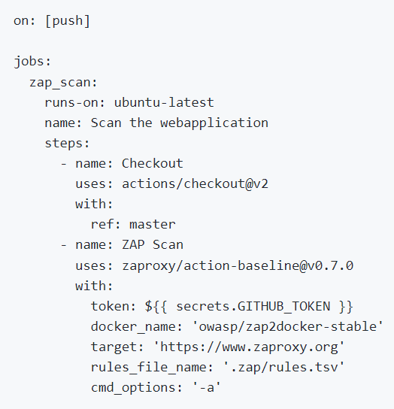
Notes:
Andy
Source: https://github.com/marketplace/actions/owasp-zap-baseline-scan

Slide 34
Recommendation:
DAST: CD and/or scheduled
Popular Tools: ZAP, StackHawk, Burp Suite, Astra Pentest, etc.
Notes:
Andy
Popular tools include: ZAP (free), StackHawk (built on ZAP - between $0 and $49 per month), Burp Suite ($8k-$35k per year), Astra Pentest ($1k and $10k per year plus), etc.
OWASP DAST tool list: https://owasp.org/www-community/Vulnerability_Scanning_Tools
DAST tool reviews: https://www.getastra.com/blog/security-audit/top-dast-tools/

Slide 35




Part 2: Active Defense for detection
Notes:
Mick
Skeleton Bomber Image: https://pixabay.com/photos/wall-breaker-clash-of-clans-online-4488105/
Hourglass image: https://pixabay.com/photos/hourglass-time-hours-clock-620397/
Honeypot image: https://pixabay.com/photos/honey-table-pot-white-wood-2588187/
Labyrinth image: https://pixabay.com/illustrations/labyrinth-puzzle-maze-target-away-2037286/

Slide 36
Part 2: Active Defense for detection FTW!!
Notes:
Mick
Skeleton Bomber Image: https://pixabay.com/photos/wall-breaker-clash-of-clans-online-4488105/
Hourglass image: https://pixabay.com/photos/hourglass-time-hours-clock-620397/
Honeypot image: https://pixabay.com/photos/honey-table-pot-white-wood-2588187/
Labyrinth image: https://pixabay.com/illustrations/labyrinth-puzzle-maze-target-away-2037286/

Slide 37
Traditional Defense == Passive
Notes:
Mick

Slide 38
Traditional Defense == KNOWN
Notes:
Mick

Slide 39
Active Defense == Passive & Active
Notes:
Mick

Slide 40
Still need to do “basics”
Notes:
Mick

Slide 41
Once you’re OK…
Notes:
Mick

Slide 42
Shift focus/effort to higher reward
Notes:
Mick

Slide 43
Honey Pots!
Notes:
Mick

Slide 44
Attackers have predictable paths
Notes:
Mick

Slide 45
TTPs
Notes:
Mick

Slide 46
MITRE ATT&CK matrix
Notes:
Mick
!!! add mitre att&ck page

Slide 47
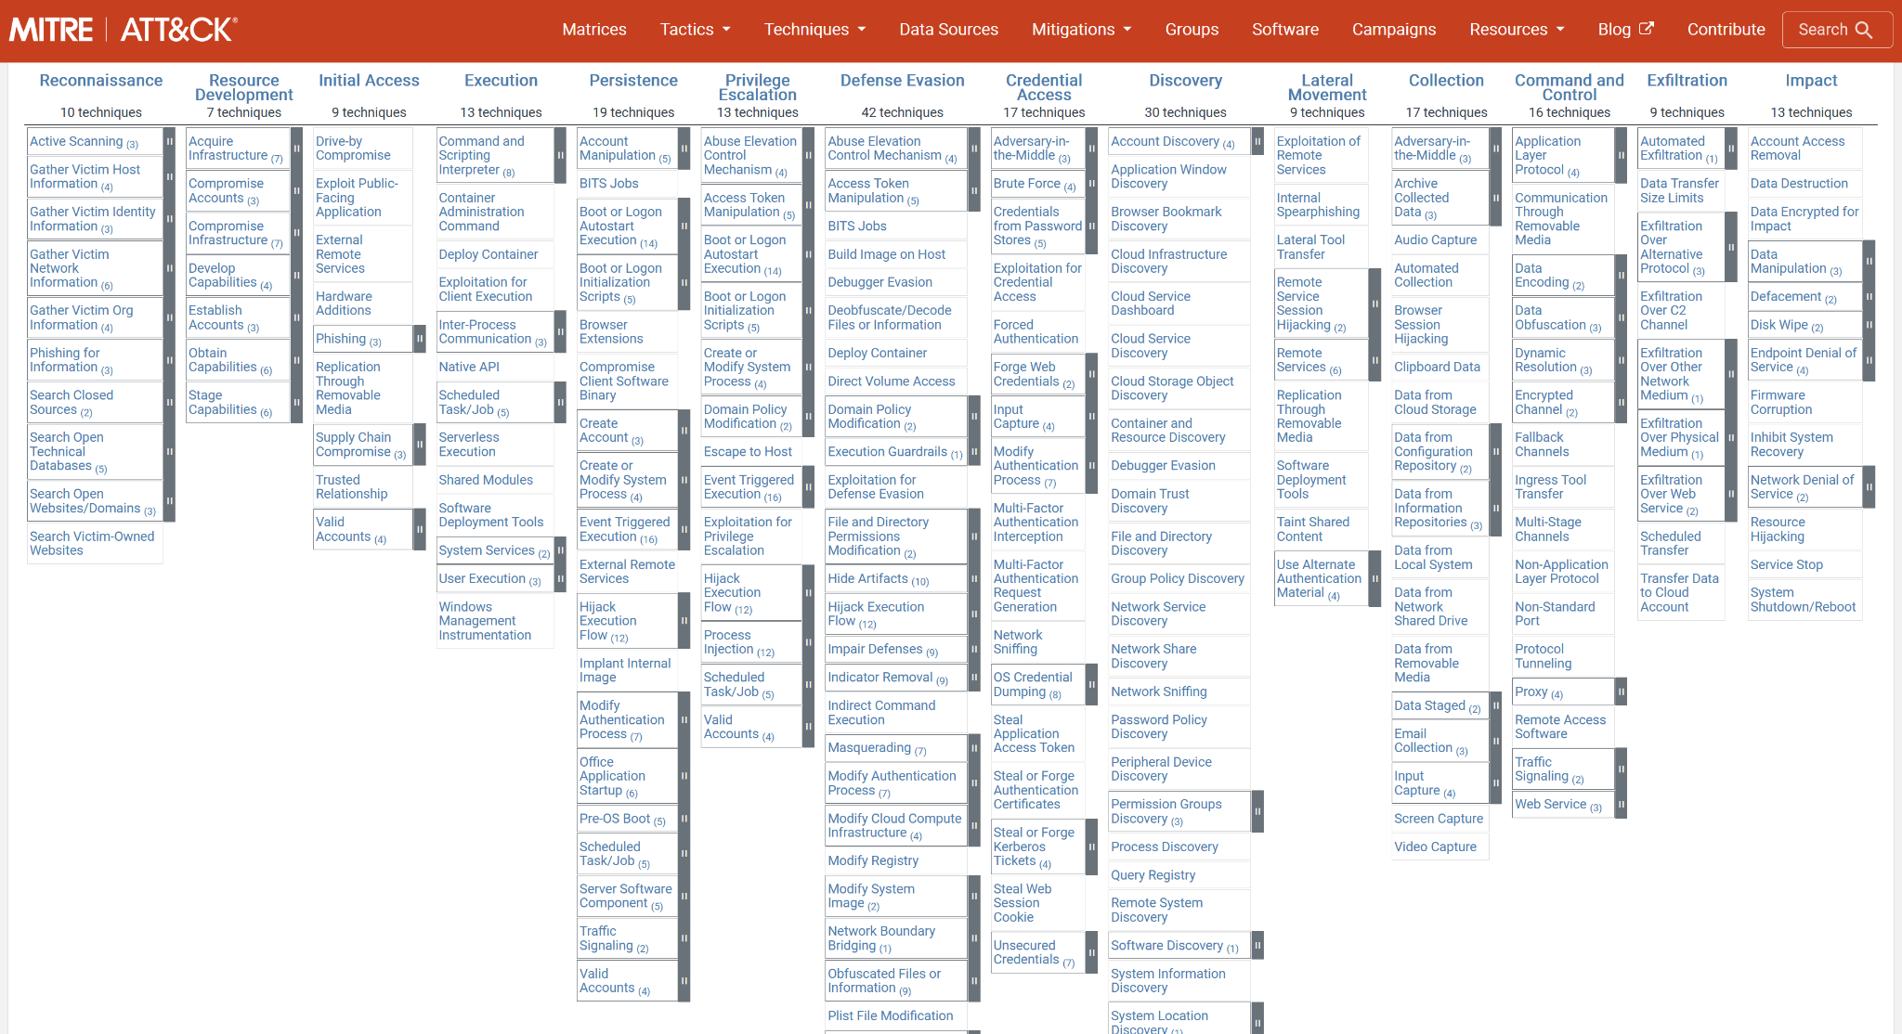
Notes:
Mick
Source: attack.mitre.org

Slide 48
Active Defence at each phase
Notes:
Andy
Each of the phases of Mitre Attack represents an opportunity to incorporate active defense

Slide 49
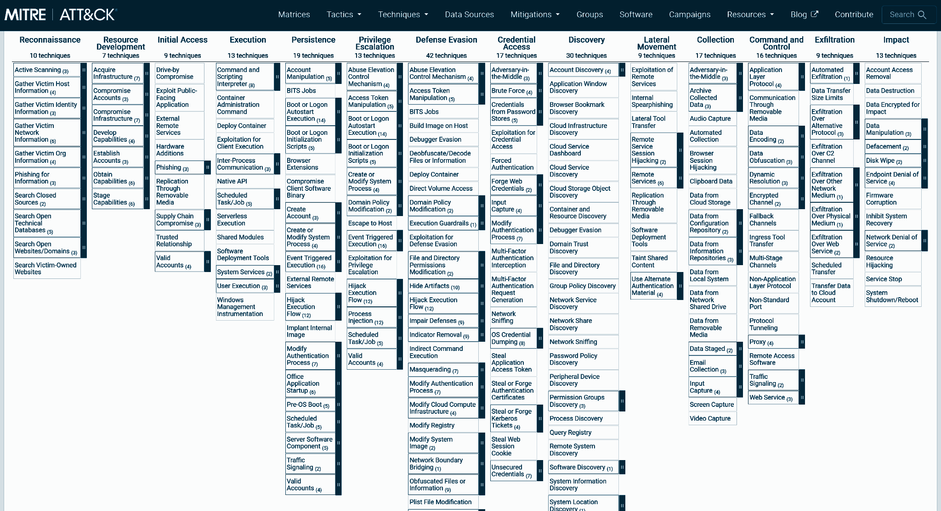
Recon: Port scanning
Notes:
Mick
Source: attack.mitre.org

Slide 50
Honey Port
Notes:
Mick

Slide 51
DEMO: Honey Port
Notes:
Mick

Slide 52
Initial Access: Admin login
Notes:
Mick
Source: attack.mitre.org

Slide 53
Honey Admin Login
Notes:
Mick

Slide 54
Demo: Honey Admin Login
Notes:
Mick

Slide 55
Privilege Escalation: Session Token
Notes:
Mick
Source: attack.mitre.org

Slide 56
Honey Session Tokens
Notes:
Mick

Slide 57
Demo: Honey Session Tokens
Notes:
Mick

Slide 58
Strategy: Post Detection
Notes:
Mick

Slide 59
Watch and learn?

Slide 60
Random error response?
Notes:
Mick

Slide 61
Firewall
Notes:
Mick

Slide 62
QoS
Notes:
MIck

Slide 63
Demo response options
Notes:
Mick

Slide 64
Security != Hard/Expensive
Notes:
Mick

Slide 65
Security as Functional Requirement
Notes:
Andy
Functional requirements are related to building specific software features required to add value to software. We invite you to be *intentional* about application security and start thinking of it as a functional requirement akin to the critical features you’re adding in the software you deliver.

Slide 66
Security + CI/CD is good
Notes:
Andy
We recommend incorporating SAST, SCA, DAST, Active Defense. The free DAST and AD tools we demoed can easily and cheaply be incorporated into your existing pipelines to bolster your organization’s security posture.

Slide 67
Challenge - Join Us!
Notes:
Mick
We’ve curated, tuned, and automated, pre-existing development and security techniques to provide coordinated, layered, and measurable improvements to the defensive posture of software stacks at key choke points throughout the SDLC
We challenge you to join us in a more resilient future.

Slide 68
Building a secure-by-default system is a choice.
Building an expensive, insecure, and inefficient one is also a choice.
Choose wisely.
-Mick Douglas
Notes:
Andy

Slide 69

Resources
Presentation and related labs:
GitHub repo with slides, demos, and labs: →
OWASP SAST Recommendations
OWASP SCA Recommendations
OWASP ZAP
(YouTube) ZAP Automation in CI/CD
ModSecurity
Misc related resources:
Offensive Countermeasures: The Art of Active Defense by John Strand
Mick Douglas
https://www.infosecinnovations.com/
Andy Douglas
https://www.linkedin.com/in/andy-douglas-8187557/
Notes:
Andy

